Slide 1
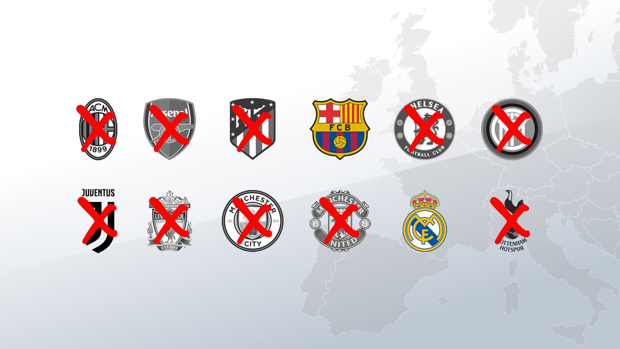
THE SUPERLEAGUE CASE
ESLC v.FIFA and UEFA
(A22 Sports Management – RFEF-LNFP) by Michele Colucci

Slide 2
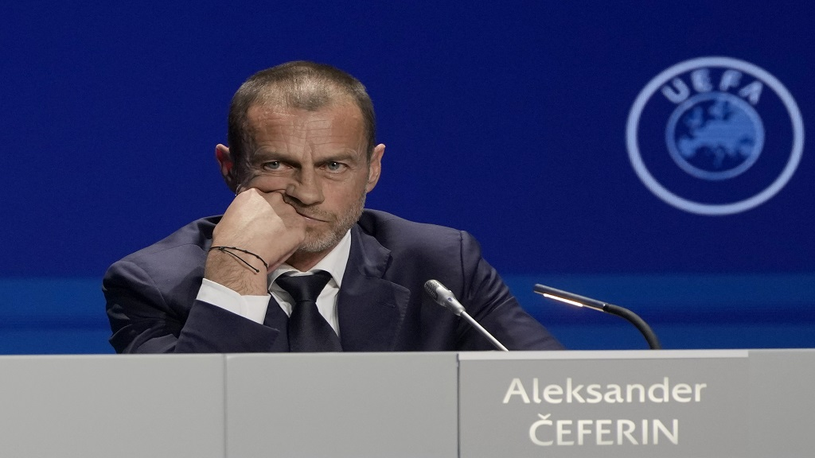
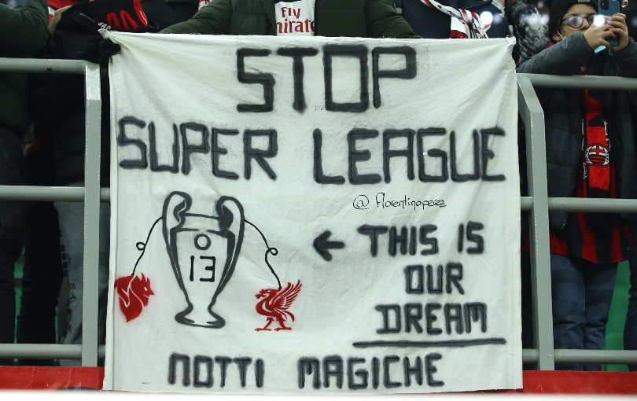

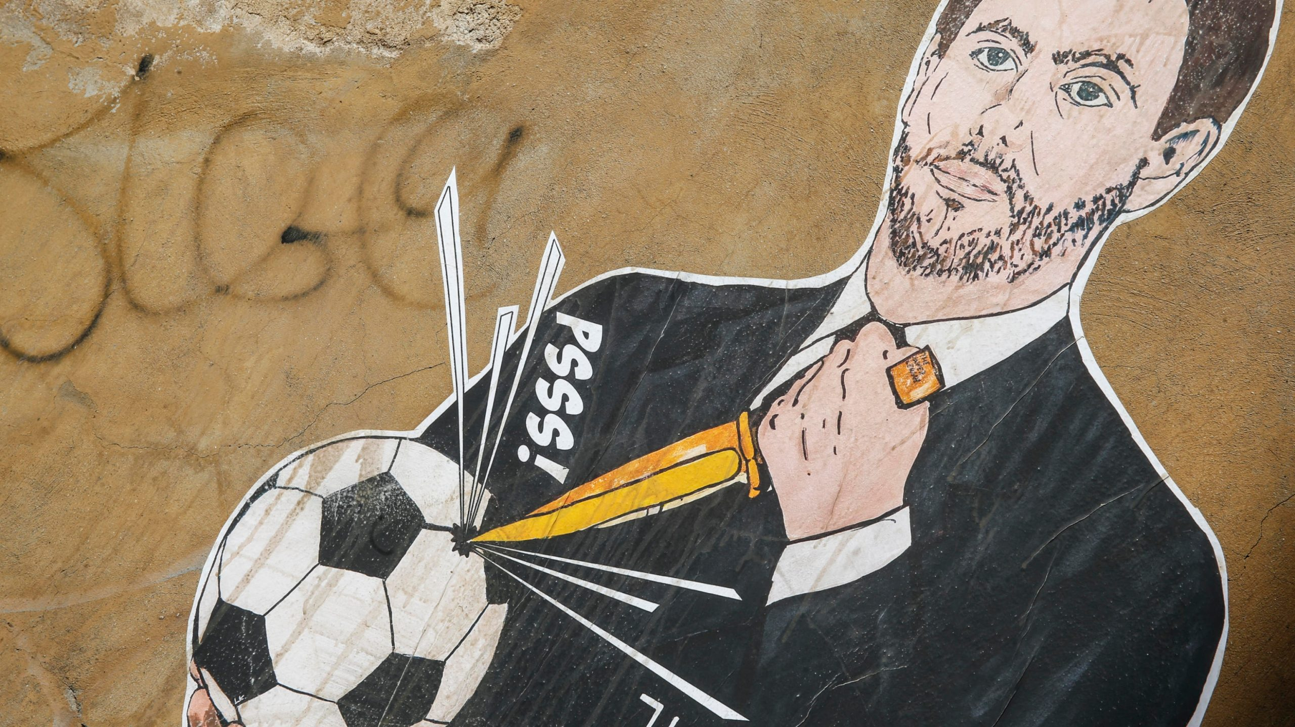
21 January 2021

Slide 3

The Super League Project
European Superleague Company SL
Nature: Private Company under Spanish Law (12 clubs)
Goal: new International interclub competitions
Means:
3 companies for:
Management of the competition
Exploitation of media rights
Exploitation of other commercial rights
JP Morgan : financial support (4 billion EUR)

Slide 4

Three Rules at stake
FIFA-UEFA “prior approval” rules of any international football competitions
Clauses obliging Clubs and Players to participate only to their competitions, on pain of exclusion.
Provisions for FIFA and UEFA as “original owners” of all sporting rights (“exclusive exploitation”)

Slide 5
Six Preliminary Questions on FIFA and UEFA Rules
Prior Authorization: Art.102 TFEU on abuse dominant position
Prior authorization: Art. 101 TFEU on free competition
Threat of sanctions: Artt. 101 and 102 TFEU
“Original Owners of rights”: Artt. 101 and 102 TFEU
Prior Authorization “exception” : Art.101 (3) and 102 TFEU
Prior Authorization: Artt. 45-49 -56 and 63 TFEU (freedom of movement)

Slide 6

Is Prior Approval in line with Art. 102 TFEU?
UEFA – FIFA dominant position
“Special responsibility” :
Prevent undistorted competition
Not unduly deny access to the market ( para.131)

Slide 7
UEFA AND ITS DUAL ROLE
REGULATORY
ECONOMIC

Slide 8

POWER TO:
AUTHORISE AND SETTING UP A NEW COMPETITION
CONTROL THE PARTICIPATION OF FOOTBALL CLUBS AND PLAYERS
SANCTIONS

Slide 9
CONFLICT OF INTEREST BUT IT IS LEGITIMATE TO HAVE:
Common rules for homogeneity and coordination of competitions, equal opportunities and merits (para.144)
Prior authorization system (para.145)
Sanctions (para.146)
BUT…

Slide 10

Compliance with Art. 102 TFEU
FEDERATIONS NEED TO HAVE (paras 147-148):
SUBSTANTIVE CRITERIA and DETAILED PROCEDURAL RULES:
TRANSPARENCY
OBJECTIVITY (no discretion)
PRECISION
NON DISCRIMINATION

Slide 11

Compliance with Art. 102 TFEU
Proportionality of sanctions (para.148)
Accessibility of Rules prior to their implementation (para.151)
Irrelevant that new competitions are not subject to FIFA and UEFA rules because of their control on national football associations, clubs and players

Slide 12

Compliance with Art. 102 TFEU
CONCLUSIONS
UEFA and FIFA prior approval system is an abuse of dominant position!

Slide 13

Art. 101 TFEU
FIFA and UEFA Prior Authorization =
    Obligation for players and clubs to participate to their competitions +
    Prohibition to participate in “third competitions”
    Sanctions

Slide 14
Art. 101 TFEU
Agreement having an anticompetitive object? namely:
  Collusive conduct leading to price fixing
  Limitation on production capacity
  Horizontal agreements leading to exclusion of competitive undertakings (para.164)

Slide 15
UEFA and FIFA :“Dual Role”
Undertaking and Association of Undertaking
Regulatory role: adopting rules for professional football
Economic role: organizing sporting competitions
Giving the power to:
Authorise the setting up and organization of new competition
Control the participation of professional football clubs and players, on pain of sanction (171)

Slide 16
Consequences (para.173):
IF No FIFA (and national association)’s Approval
No Creation of other international Leagues
Players and clubs cannot play and cannot make sports contacts with no affiliated players and clubs

Slide 17
Consequences (para.173):
No FIFA and UEFA approval …
No match and no competition
No participation in other competitions of other national associations

Slide 18

LEGITIMATE OBJECTIVES
Observance of:
Principles
Values, and
Rules of the game (para.176)

Slide 19
BUT…NO:
SUBSTANTIVE CRITERIA
DETAILED PROCEDURAL RULES
TRANSPARENCY, OBJECTIVITY, NON- DISCRIMINATION (para.175)

Slide 20
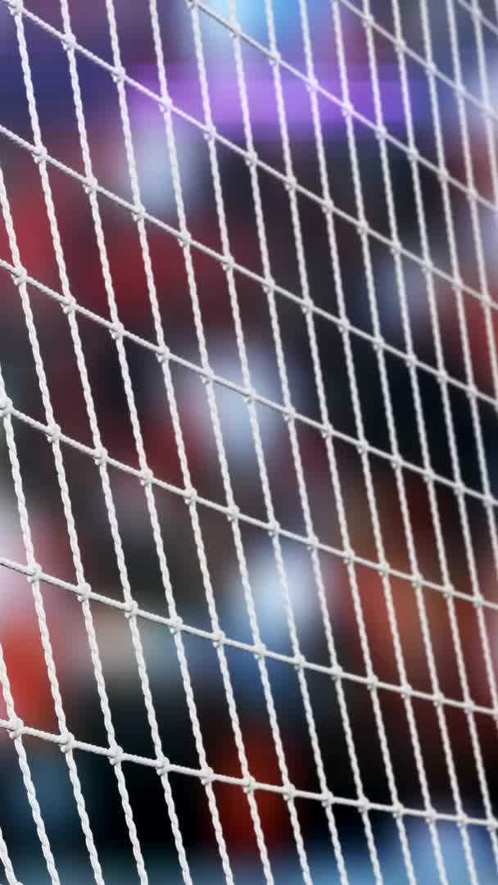
Consequences
FIFA and UEFA RULES:
“if not exclude” competitors from the market, they restrict the creation of alternative and “innovative” formats
Spectators cannot attend those competitions (para.176)
Reinforce the barrier to entry in the market (para.177) because third entities clubs and players (vulnerable for sanctions)

Slide 21

CONCLUSIONS:
FIFA AND UEFA RULES CONTRARY TO ART.101 TFEU

Slide 22

ARE SANCTIONS against Art. 101 and 102 TFEU?
  OF COURSE THEY ARE!
  THEY AIM TO IMPLEMENT AN ILLEGAL REGIME (para.180)

Slide 23


Exemptions?
Artt. 101 (3) and 102 TFEU
    FOUR cumulative conditions:
    1. The agreement result in efficiency gains
    2. Consumers receive a fair share of the benefits
    3.Restrictions are necessary to achieving those benefits
    4.There is no substantial elimination of competition

Slide 24
Exemptions
BURDEN OF PROOF ON FIFA AND UEFA
NATIONAL JUDGE will decide if favourable impact on ”users”:
National football associations
Professional or amateur clubs
Professional or amateur players
Young players
Spectators and TV viewers
BUT also ”solidarity contribution”

Slide 25

HINT (para. 99):
    No substantive criteria and no detailed procedural rules
    No transparency, clarity neutrality, precision and proportionality…
    Prevention of any and all competition on the market

Slide 26

Exploitation of all rights relating to sports competitions
Artt. 101 and 102 TFEU
FIFA and UEFA “original owners”
FIFA : exclusive power on exploitation and use of those rights

Slide 27
CONSEQUENCES
No access to clubs in the marketing of those rights
No access to third undertakings
Detrimental for consumers and TV users
Standardization of Buyers’ conduct
Less choice and less innovation

Slide 28
THUS:
RESTRICTION OF COMPETITION AND ABUSE OF DOMINANT POSITION

Slide 29
Exploitation of rights relating to sporting competitions
Artt. 101 and 102 TFEU : JUSTIFICATIONS
GENUINE FINANCIAL SOLIDARITY (para.235)
BETTER PRODUCTION AND REDISTRIBUTION RIGHT
CONCRETE EVIDENCE FOR THE NATIONAL JUDGE (para.236)

Slide 30

Compatibility with EU Freedom to provide services :
    Art. 56 TFEU: NO to rules prohibiting, impeding or rendering less attractive the activity of service providers
    PRIOR Authorization as obstacle to Freedom to provide services for third organisers and clubs
    Obstacle to freedom of movement

Slide 31
What’s next?
- ALL SPORTS (INTERNATIONAL AND NATIONAL° FEDERATIONS NEED TO COMPLY WITH THIS CASE LAW
- CONTROL BY THE EUROPEAN COMMISSION
31

